Slide 1
Religion, Faith & Morality
By Eduardo S. Sucob, Jr.

Slide 2
Learning Objectives
By the end of this presentation, you will be able to:
Explain the differences between various types of religious organizations;
Understand classification of religion;
Describe several major world religions; and,
Discuss how religion affects our actions in life.

Slide 3
Religion Defined
Religion is a set of beliefs concerning the cause, nature, and purpose of the universe, especially when considered as the creation of superhuman agency or agencies (god/s; deities), usually involving devotional and ritual observances, and often containing a moral code governing the conduct of human affairs.
“A religion is a unified system of beliefs and practices relative to sacred things, that is to say, things set apart and forbidden – beliefs and practices which unite into one single moral community called a Church, all those who adhere to them” – Emile Durkheim

Slide 4
Types of religious organizations
Cult – are new religious groups. The term often carries a bad connotation. However, almost all religions began as cults and gradually progressed to levels of greater size and organization. The term cult is sometimes used interchangeably with the term new religious movement (NRM). In its pejorative use, these groups are often disparaged as being secretive, highly controlling of members’ lives, and dominated by a single, charismatic leader.

Slide 5
Types of religious organizations
Sect – a small and relatively new group. Most of the well-known Christian denominations in the United States today began as sects. For example, the Methodists and Baptists protested against their parent Anglican Church in England, just as Henry VIII protested against the Catholic Church by forming the Anglican Church. From “protest” comes the term Protestant.
Occasionally, a sect is a breakaway group that may be in tension with larger society. They sometimes claim to be returning to “the fundamentals” or to contest the veracity of a particular doctrine. When membership in a sect increases over time, it may grow into a denomination. Often a sect begins as an offshoot of a denomination, when a group of members believes they should separate from the larger group.

Slide 6
Types of religious organizations
Denomination – is a large, mainstream religious organization, but it does not claim to be official or state sponsored. It is one religion among many. For example, Baptist, African Methodist Episcopal, Catholic, and Seventh-day Adventist are all Christian denominations.

Slide 7
Types of religious organizations
Ecclesia – originally referring to a political assembly of citizens in ancient Athens, Greece, now refers to a congregation. In sociology, the term is used to refer to a religious group that most all members of a society belong to. It is considered a nationally recognized, or official, religion that holds a religious monopoly and is closely allied with state and secular powers. The United States does not have an ecclesia by this standard; in fact, this is the type of religious organization that many of the first colonists came to America to escape.

Slide 8
Types of religious organizations
One way to remember these religious organizational terms is to think of cults, sects, denominations, and ecclesia representing a continuum, with increasing influence on society, where cults are least influential and ecclesia are most influential.

Slide 9
Types of religions
Scholars from a variety of disciplines have strived to classify religions. One widely accepted categorization that helps people understand different belief systems considers what or who people worship (if anything). Using this method of classification, religions might fall into one of these basic categories:
  1. Theism
  2. Agnosticism
  3. Atheism

Slide 10
Theism
The belief in the existence of the Supreme Being or deities. Can be further classified into:
  a. Monotheism – the belief in theology that only one god/deity exists. (e.g. Christianity, Judaism, Islam)
  b. Polytheism – the belief that there is more than one god. (e.g. the belief system of the ancient Greeks and Romans)
  c. Deism – the belief that one God exists and created the world, but that the creator does not alter the original plan for the universe. (Neo-Platonists)
  d. Animism – the belief that non-human beings are divine (animals, plants, natural world). (Indigenous worship nature, Shintoism)
  e. Pantheism – the belief that the physical universe is equivalent to god, and that there is no division between the Creator and the substance of its creation.

Slide 11
Types of religions
Agnosticism – the view that the existence of God, of the divine or the supernatural is unknown or unknowable
Atheism – the absence of belief in the existence of deities. Atheism is contrasted with theism, which, in its most general form, is the belief that at least one deity exists.
While typically not an organized group, atheists and agnostics represent a significant portion of the population. It is important to recognize that being a nonbeliever in a divine entity does not mean the individual subscribes to no morality. Indeed, many Nobel Peace Prize winners and other great humanitarians over the centuries would have classified themselves as atheists or agnostics.

Slide 12
TOP Five Religion in the world
Religions have emerged and developed across the world. Some have been short-lived, while others have persisted and grown. In this section, we will explore the top five of the world’s major religions (based on number of members).
1. Christianity (Roman Catholic, Greek Orthodox, Protestants)
2. Islam (Sunni, Shia)
3. Hinduism
4. Buddhism
5. Judaism

Slide 13
Christianity
Today the largest religion in the world, Christianity began 2,000 years ago in Palestine, with Jesus of Nazareth, a charismatic leader who taught his followers about caritas (charity) or treating others as you would like to be treated yourself.
The sacred text for Christians is the Bible. Different Christian groups have variations among their sacred texts. For instance, Mormons, an established Christian sect, also use the Book of Mormon, which they believe details other parts of Christian doctrine and Jesus’ life that aren’t included in the Bible. Similarly, the Catholic Bible includes the Apocrypha, a collection that, while part of the 1611 King James translation, is no longer included in Protestant versions of the Bible.
Although monotheistic, Christians often describe their god through three manifestations that they call the Holy Trinity: the father (God), the son (Jesus), and the Holy Spirit. The Holy Spirit is a term Christians often use to describe religious experience, or how they feel the presence of the sacred in their lives.
One foundation of Christian doctrine is the Ten Commandments, which decry acts considered sinful, including theft, murder, and adultery.

Slide 14
ISlam
Islam is monotheistic religion and it follows the teaching of the prophet Muhammad, born in Mecca, Saudi Arabia, in 570 C.E. Muhammad is seen only as a prophet, not as a divine being, and he is believed to be the messenger of Allah (God), who is divine. Islam means “peace” and “submission.”
The followers of Islam are called Muslims.
The sacred text for Muslims is the Qur’an (or Koran).
As with Christianity’s Old Testament, many of the Qur’an stories are shared with the Jewish faith.
Divisions exist within Islam, but all Muslims are guided by five beliefs or practices, often called “pillars”

Slide 15
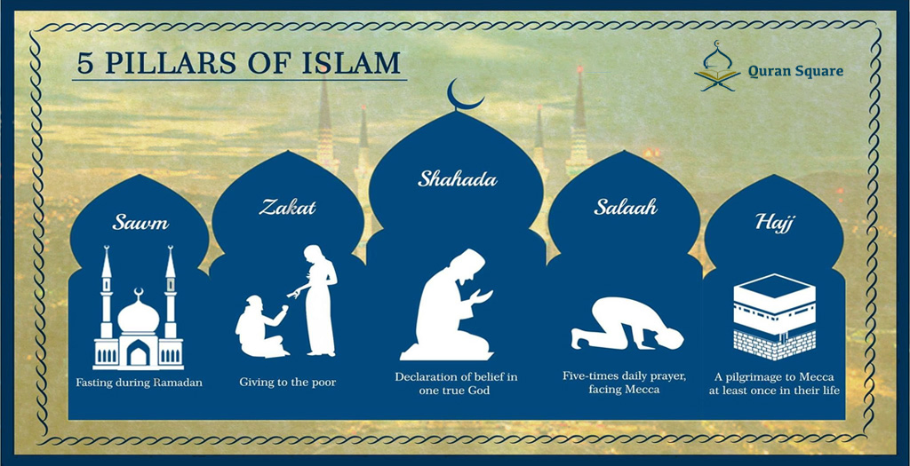
Islam

Slide 16
Hinduism
The oldest religion in the world, Hinduism originated in the Indus River Valley about 4,500 years ago in what is now modern-day northwest India and Pakistan. It arose contemporaneously with ancient Egyptian and Mesopotamian cultures.
With roughly one billion followers, Hinduism is the third-largest of the world’s religions.
Hindus believe in a divine power that can manifest as different entities. Three main incarnations—Brahma, Vishnu, and Shiva—are sometimes compared to the manifestations of the divine in the Christian Trinity.
Multiple sacred texts, collectively called the Vedas, contain hymns and rituals from ancient India and are mostly written in Sanskrit.
Hindus generally believe in a set of principles called dharma, which refer to one’s duty in the world that corresponds with “right” actions. Hindus also believe in karma, or the notion that spiritual ramifications of one’s actions are balanced cyclically in this life or a future life (reincarnation).

Slide 17
Buddhism
Buddhism was founded by Siddhartha Gautama around 500 B.C.E. Siddhartha was said to have given up a comfortable, upper-class life to follow one of poverty and spiritual devotion. At the age of thirty-five, he famously meditated under a sacred fig tree and vowed not to rise before he achieved enlightenment (bodhi). After this experience, he became known as Buddha, or “enlightened one.” Followers were drawn to Buddha’s teachings and the practice of meditation, and he later established a monastic order.
Buddha’s teachings encourage Buddhists to lead a moral life by accepting the four Noble Truths: 1) life is suffering, 2) suffering arises from attachment to desires, 3) suffering ceases when attachment to desires ceases, and 4) freedom from suffering is possible by following the “middle way.”
The concept of the “middle way” is central to Buddhist thinking, which encourages people to live in the present and to practice acceptance of others (Smith 1991). Buddhism also tends to deemphasize the role of a godhead, instead stressing the importance of personal responsibility (Craig 2002).

Slide 18
Judaism
After their Exodus from Egypt in the thirteenth century B.C.E., Jews, a nomadic society, became monotheistic, worshipping only one God.
The Jews’ covenant, or promise of a special relationship with Yahweh (God), is an important element of Judaism.
Their sacred text is the Torah, which Christians also follow as the first five books of the Bible. Talmud refers to a collection of sacred Jewish oral interpretation of the Torah.
Jews emphasize moral behavior and action in this world as opposed to beliefs or personal salvation in the next world.

Slide 19
Other Major religion
Confucianism – was the official religion of China from 200 B.C.E. until it was officially abolished when communist leadership discouraged religious practice in 1949. The religion was developed by Kung Fu-Tzu (Confucius), who lived in the sixth and fifth centuries B.C.E. An extraordinary teacher, his lessons—which were about self-discipline, respect for authority and tradition, and jen (the kind treatment of every person)—were collected in a book called the Analects.
Taoism, the purpose of life is inner peace and harmony. Tao is usually translated as “way” or “path.” The founder of the religion is generally recognized to be a man named Laozi, who lived sometime in the sixth century B.C.E. in China. Taoist beliefs emphasize the virtues of compassion and moderation. The central concept of tao can be understood to describe a spiritual reality, the order of the universe, or the way of modern life in harmony with the former two. The yin-yang symbol and the concept of polar forces are central Taoist ideas.

